Slide 1

Binomial Option Pricing Model
A Parallel Implementation on GPU
2015.06.20

Slide 2
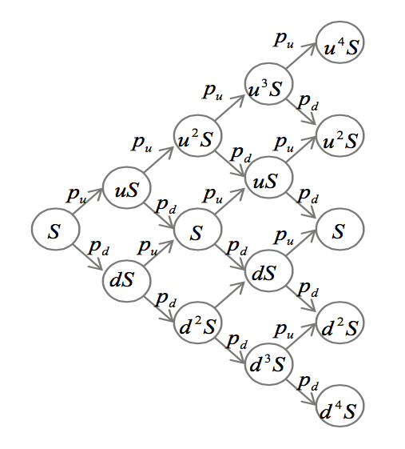
Algorithm Overview
Calculation on Binomial Tree:
Stock price S will either increase to uS or decrease to dS, where u > 1 and 0 < d < 1
The price will increase with probability pu and decrease with pd. Here pu + pd = 1.
So with an initial stock price S and other parameters, we could determine each node value in the left figure.

Slide 3
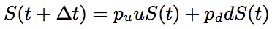
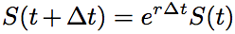
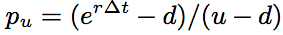
Algorithm Overview
The stock price for time t and time t + ∆t are constrained by this formula:
With risk-free assumption, those stock prices are also constrained by this equation:
So we could get the expression of pu, and with this value, we could easily calculate the expected option price at the current time, by using the calculated stock prices in the last period, which has been mentioned previously.

Slide 4
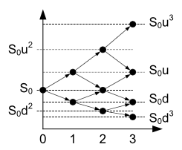
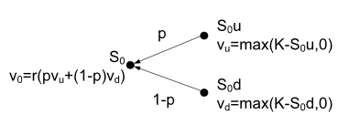
Algorithm Overview
In a word, this algorithm should be divided into 2 steps:
Initialize the binomial tree from left to right
Calculate the option prices from right to left.
Step 2.
Step 1.

Slide 5
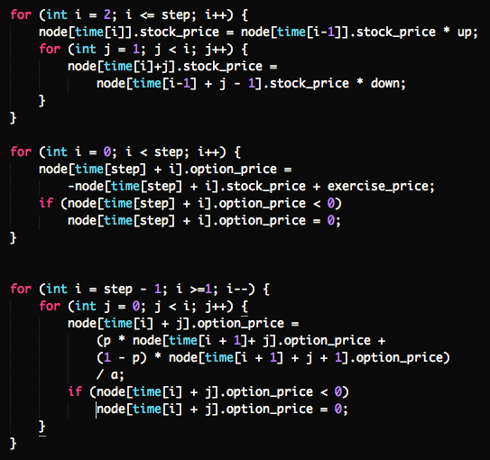
Sequential Implementation
Implemented in C++, mainly used for correctness checking.

Slide 6
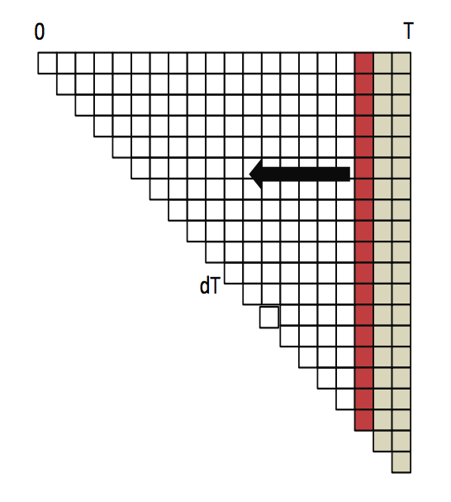
Parallel Implementation
We could easily map the calculation on one binomial tree node to one computing unit, no matter what kind of computing unit it is.
Could be thread, work item…
Here is our baseline implementation:
Implemented by using OpenCL
Take each node as a work-item. And the whole task as a work-group.
Profiled on NVidia GTX 680 and AMD Radeon HD 7700.

Slide 7
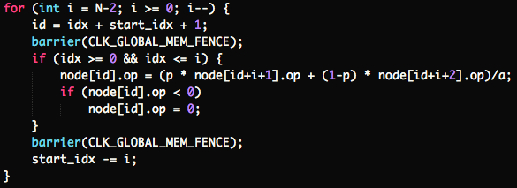
Baseline
Baseline OpenCL kernel
In each iteration, each work item will do its own calculation.
At the end of each iteration, there’ll be global memory synchronization among all the work items in this one and only workgroup.

Slide 8
Baseline
Tested on NVidia Tesla K20c
This curve show that the baseline implementation could reach O(N) time complexity, just as what we have imagined.

Slide 9
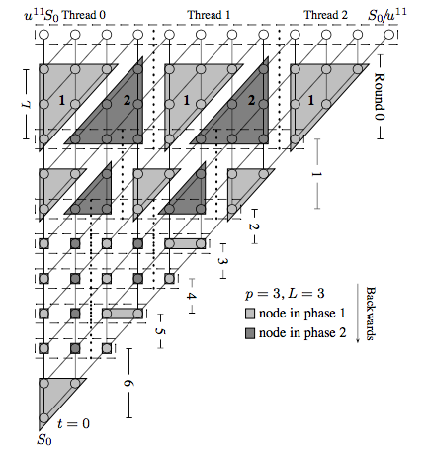
Next Steps
This baseline implementation:
Just use one workgroup, could not fully utilize GPU computing units.
The max work item number is limited, so we couldn’t do more than 1024 steps.
So we have another we to partition the workloads.

